Slide 1


1

Slide 2
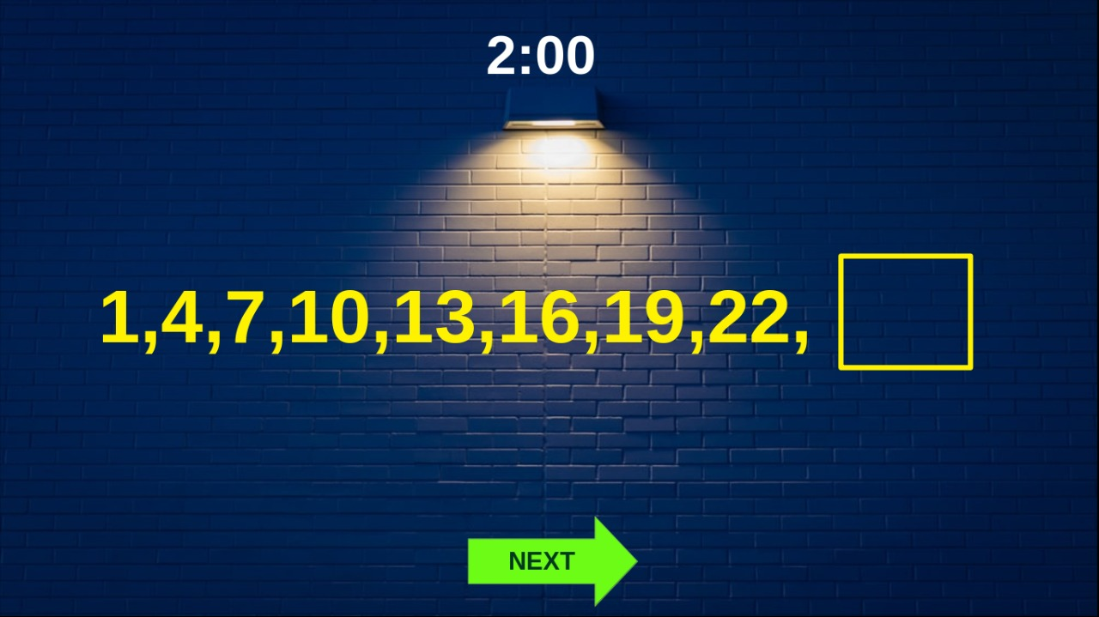
1
Number algorithms

Slide 3
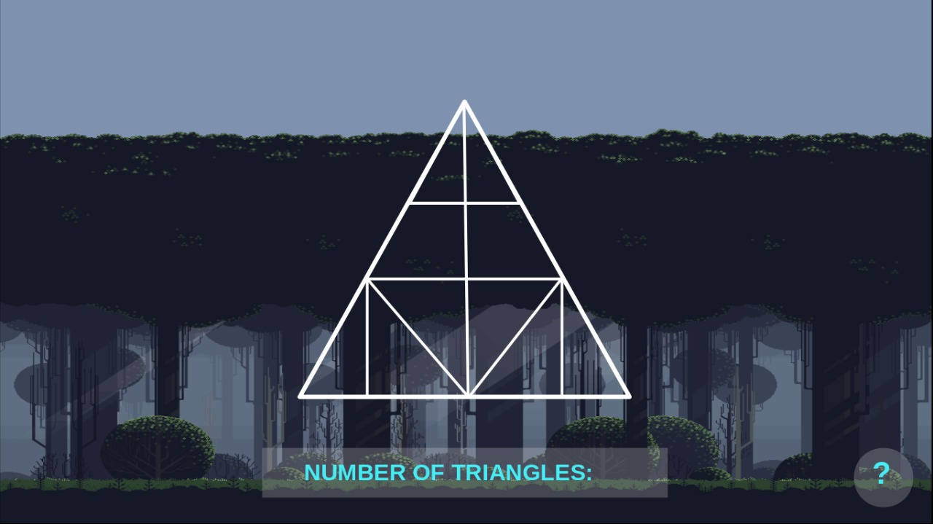
2

Slide 4

3
Shape Builder

Slide 5

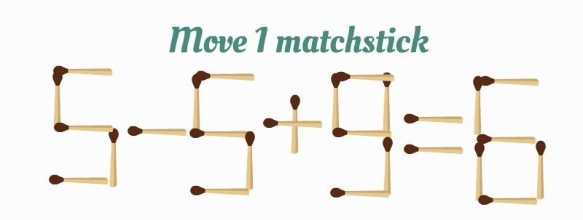
4

Slide 8
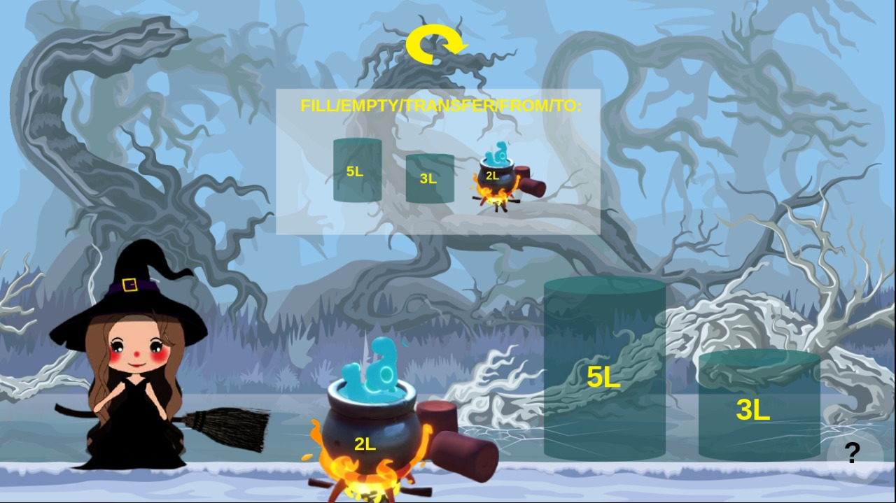
5

Slide 9
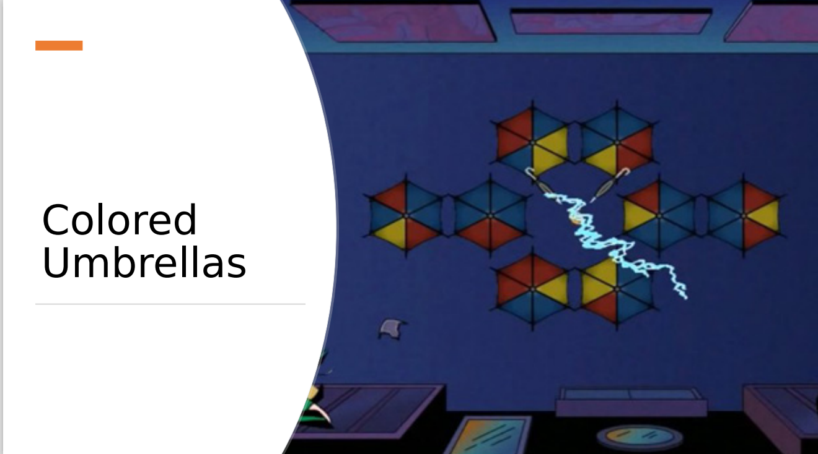
6

Slide 10
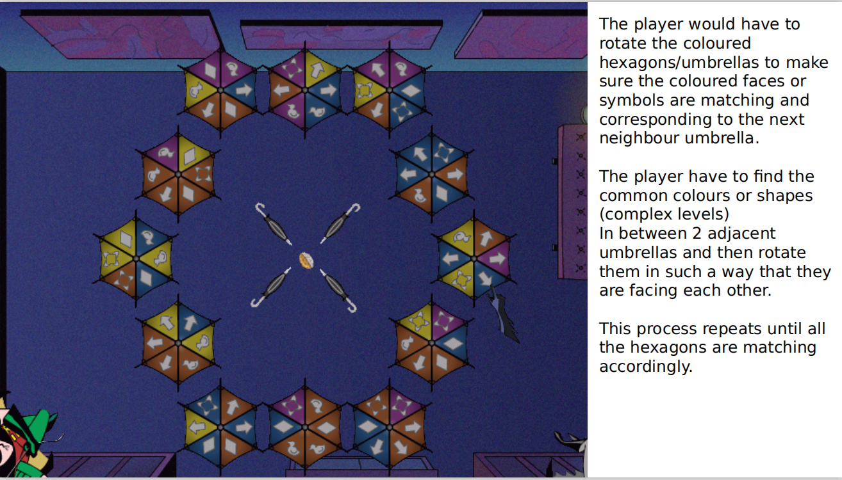

Slide 11
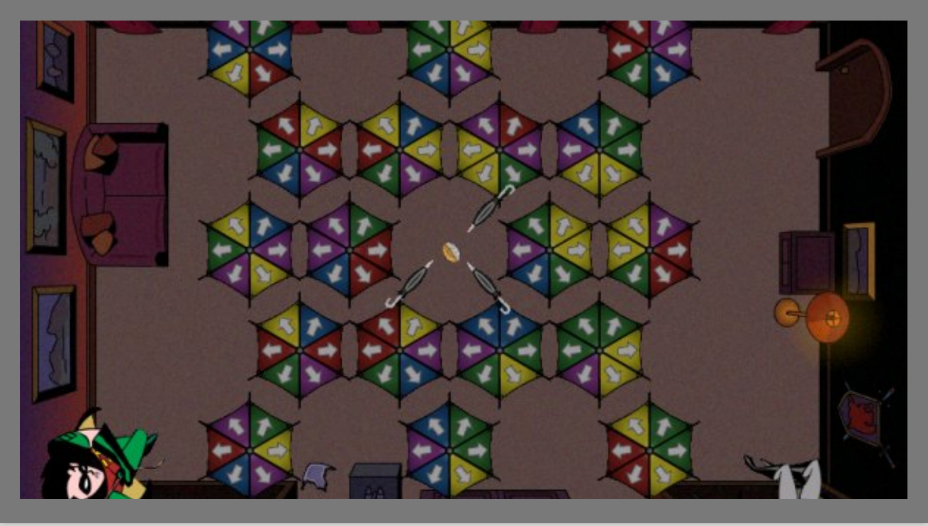

Slide 12

UNBLOCK
7
Moves: 0
Time: 4sec
Level:1

Slide 13

UNBLOCK
Moves: 5
Time: 12sec
Level:1

Slide 14
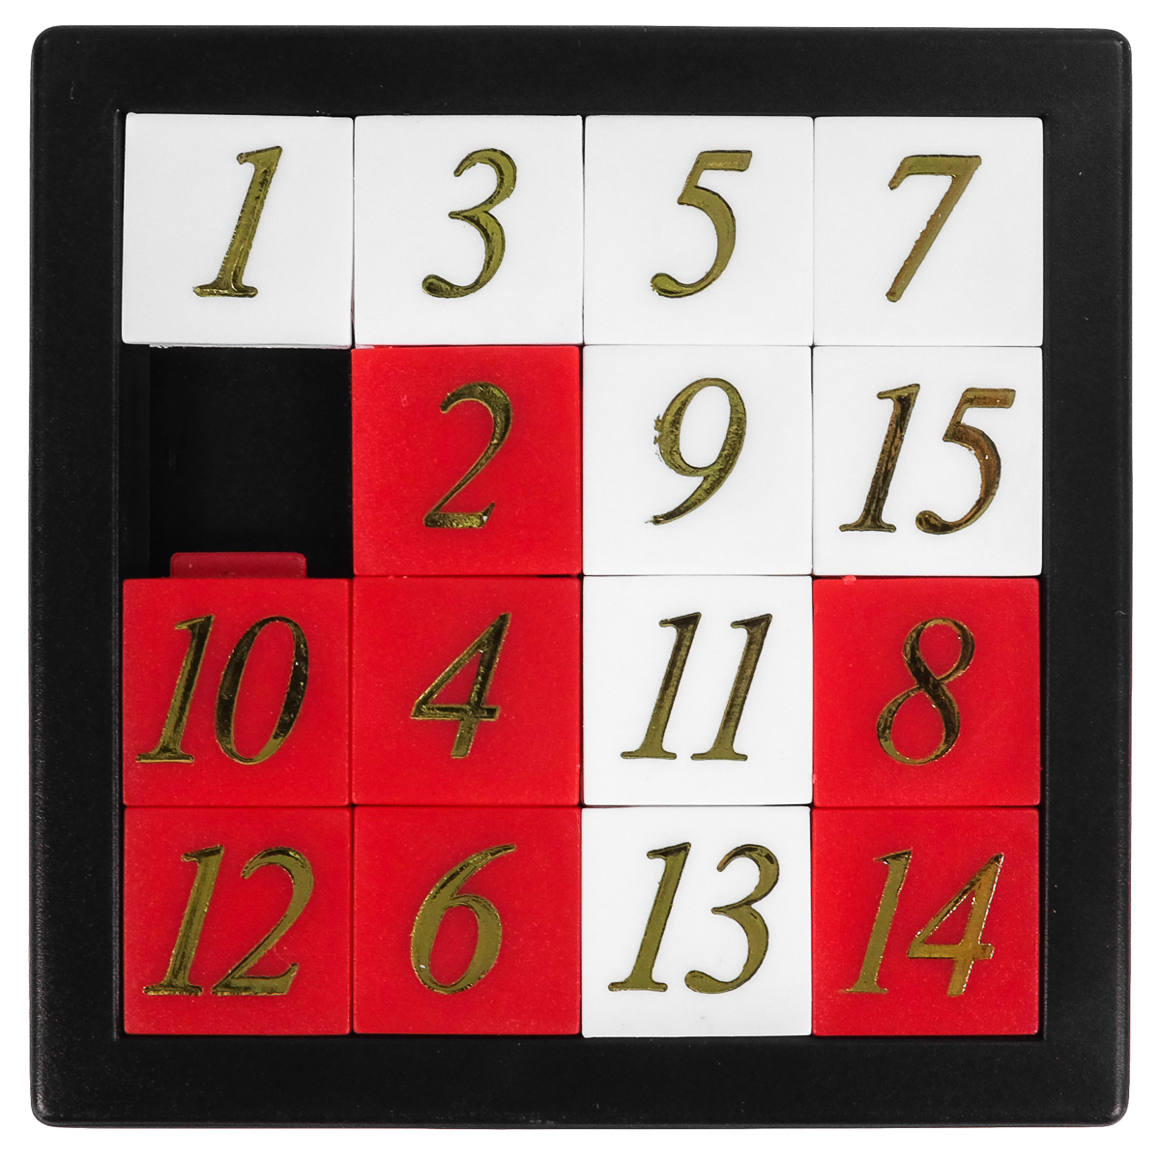
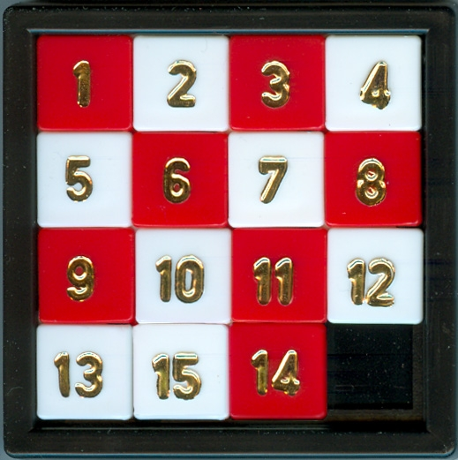
SLIDING GAME
8

Slide 15
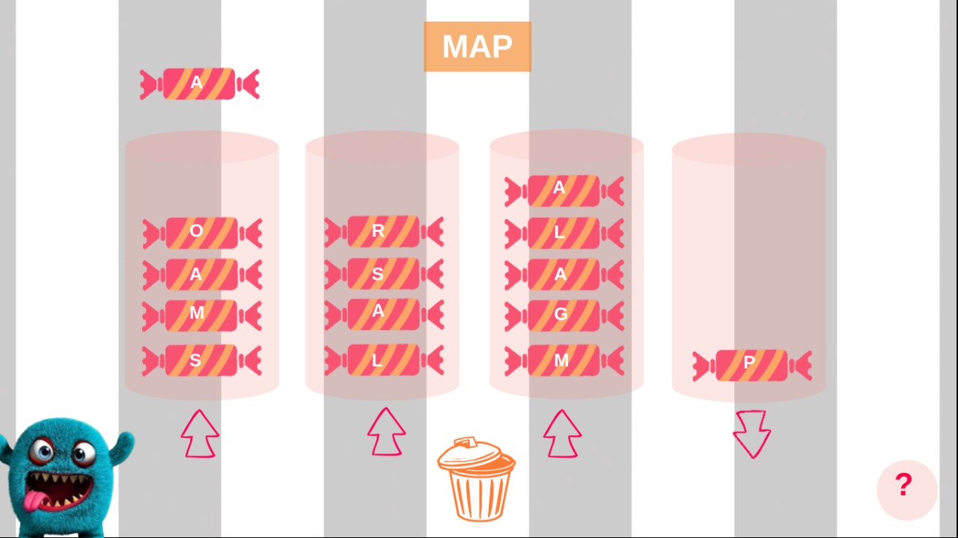
9

Slide 16
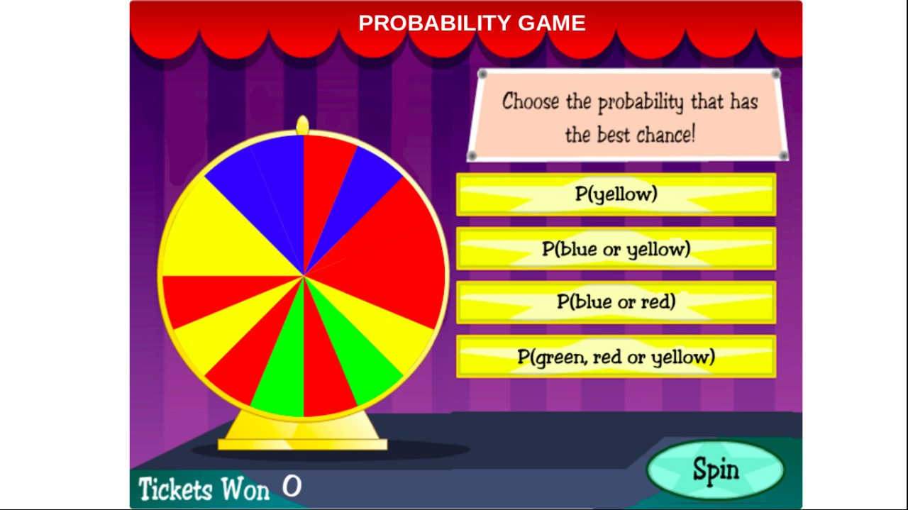
10

Slide 17
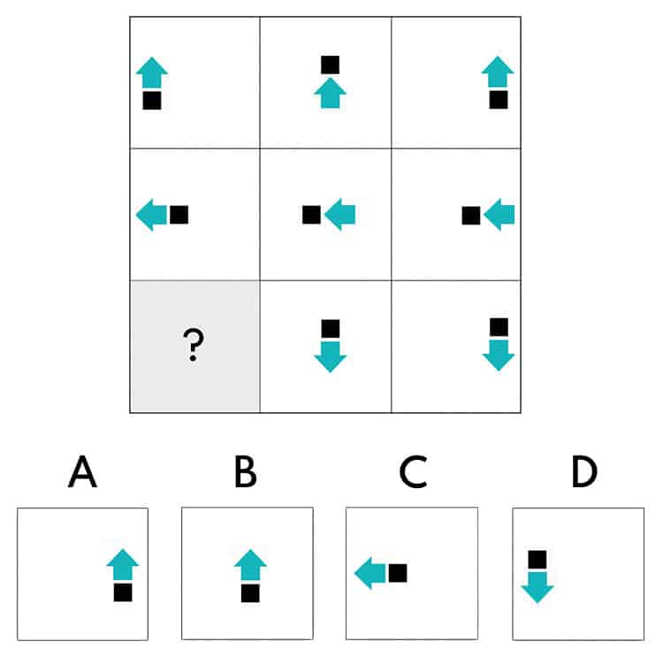
11
What comes next??
Time: 02 sec

Slide 18
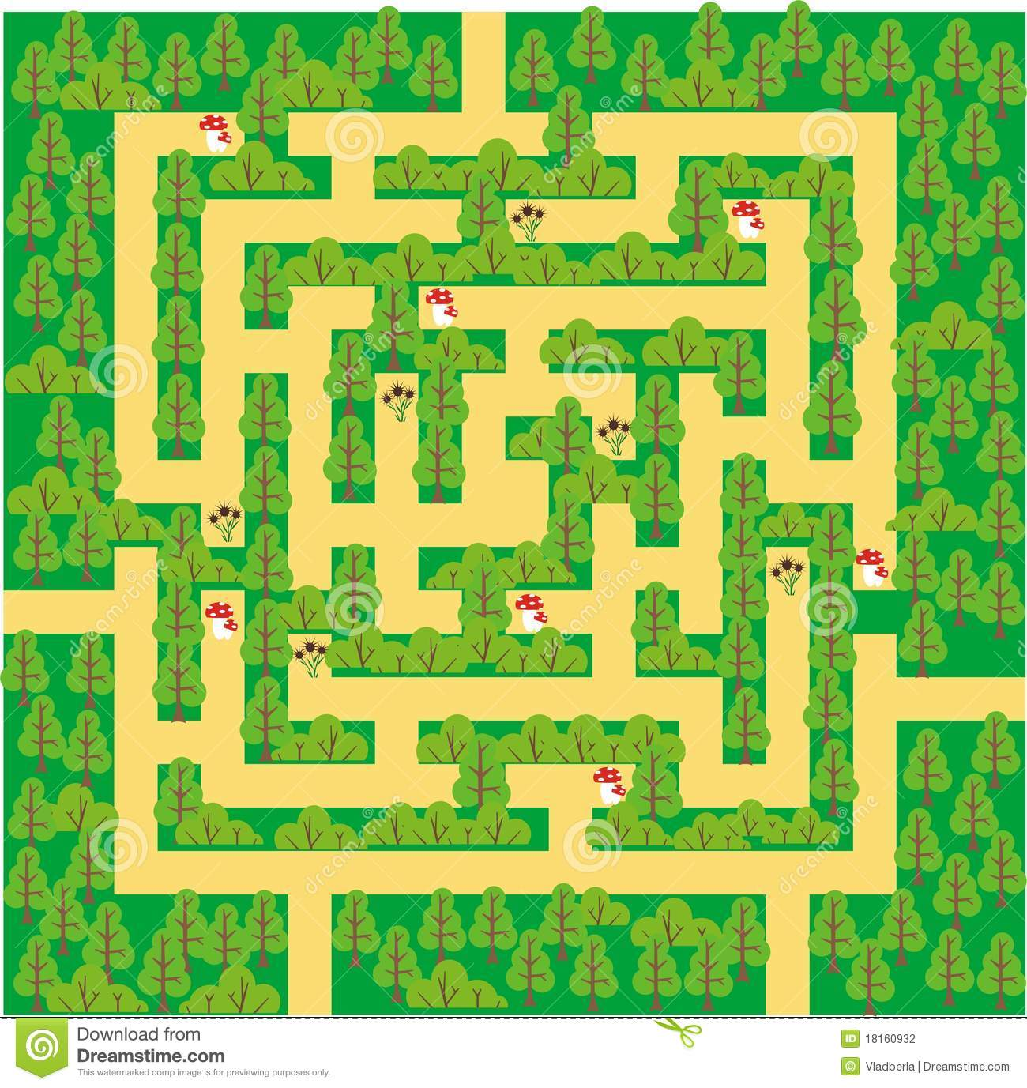


12
Help Rohit while he picks mushrooms on the way home

Slide 20









Slide 21
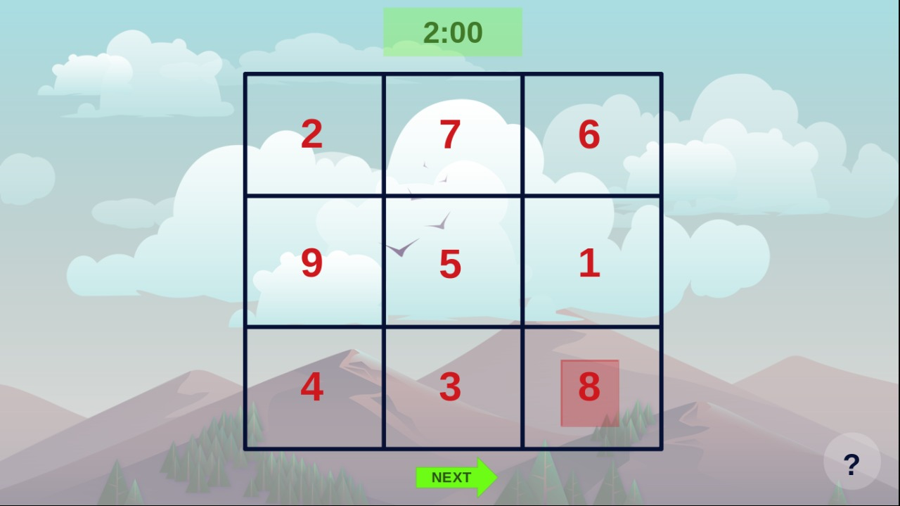
13

Slide 22
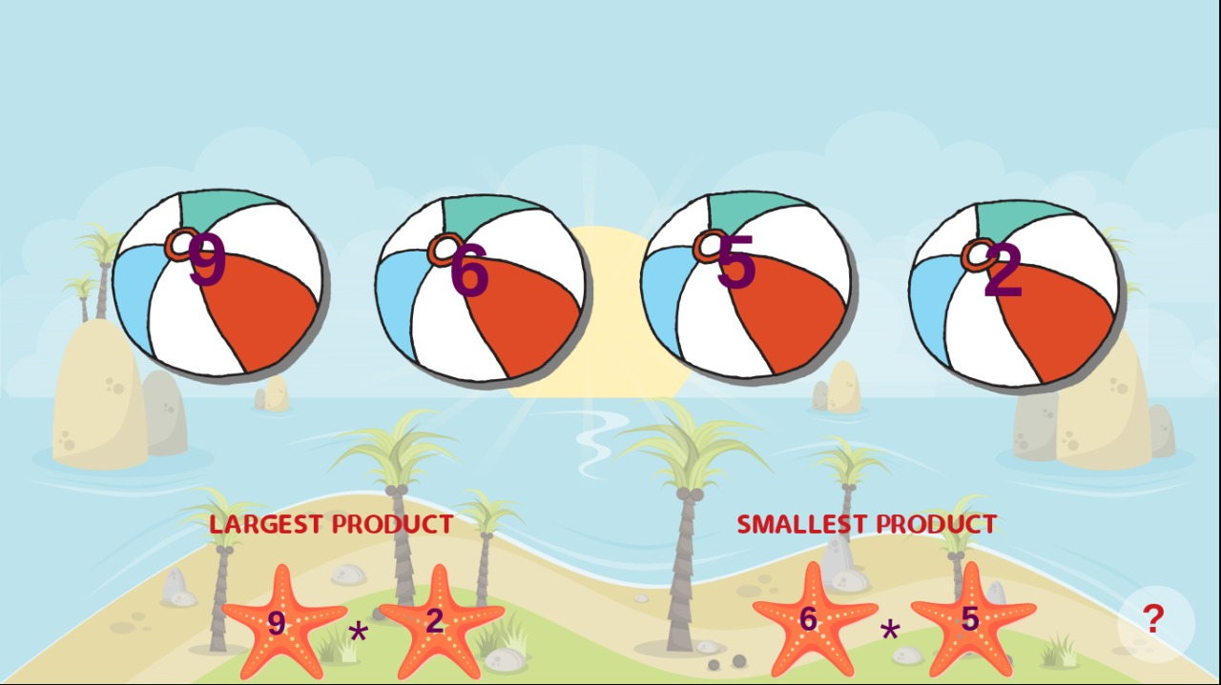
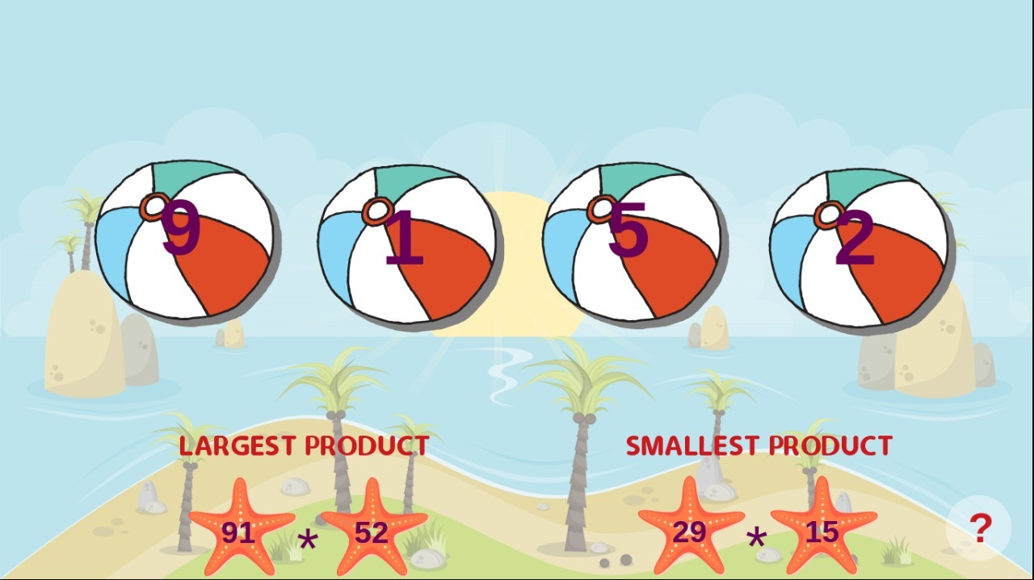
14

Slide 23

16
GEARS

Slide 24
Rules
Predict the direction of rotation the required gear given that of the first gear

Slide 25
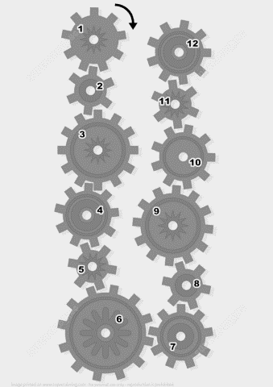
12

Slide 26
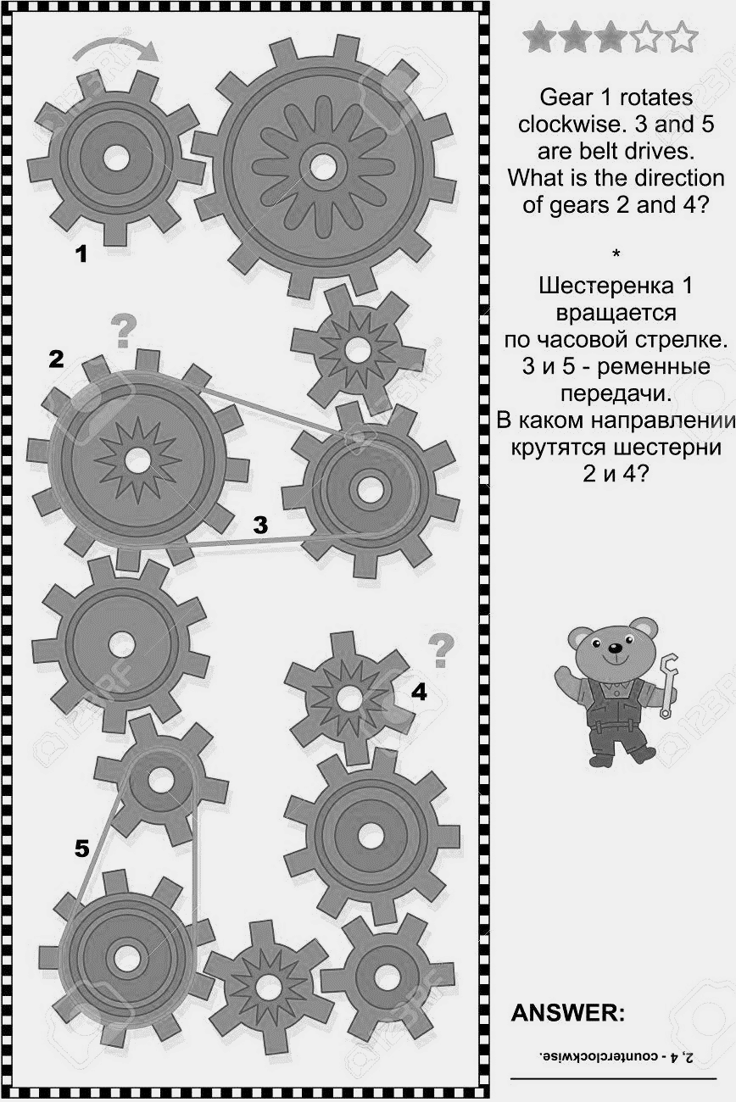
4

Slide 27
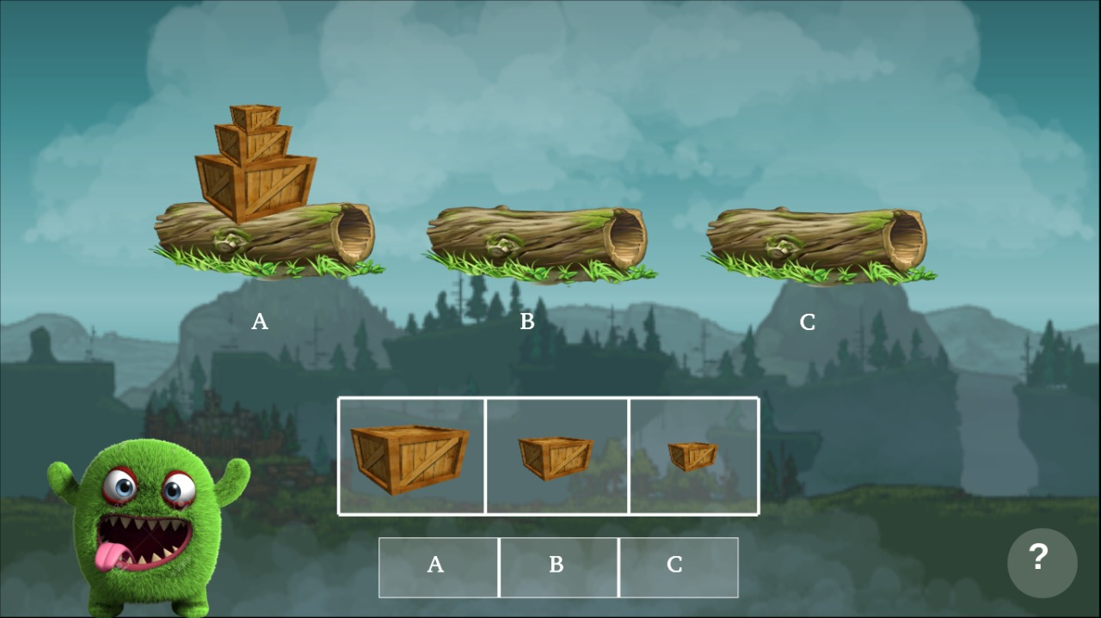
17
Tower of Hanoi

Slide 28
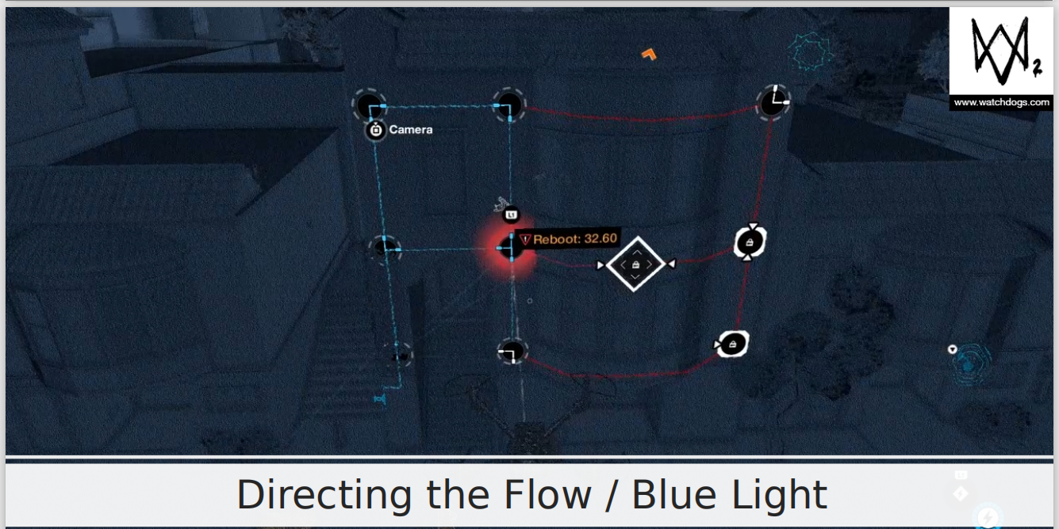
18

Slide 29
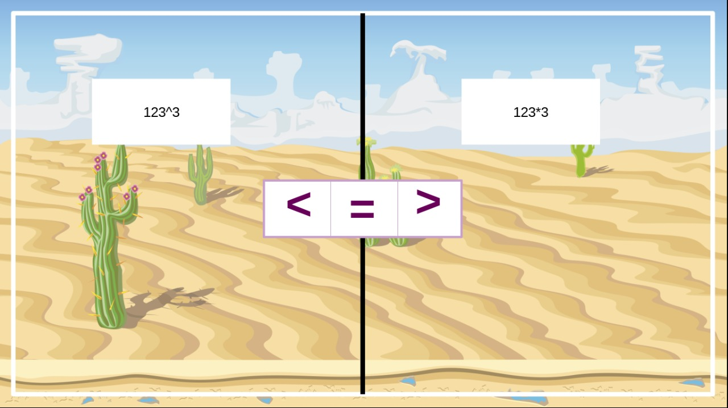
19
Logical Trouble
123*3
123^3

Slide 30

20
Checkmate
The 4 levels:
Beginner
Medium
Advanced
Expert

Slide 31





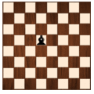
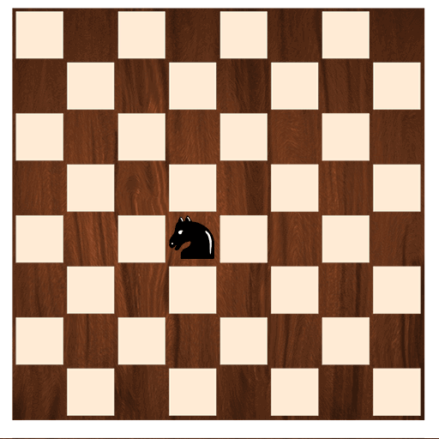
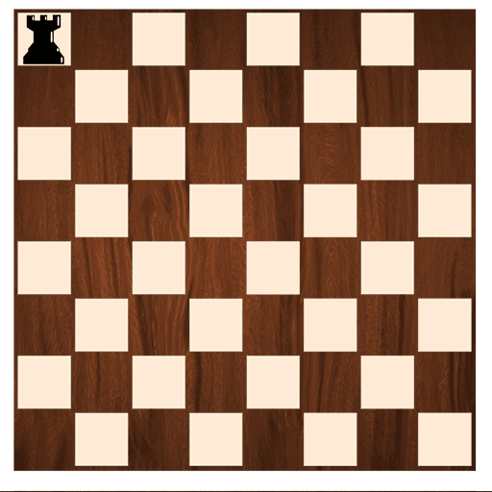
How do they move?
KING
QUEEN
PAWN
HORSE
BISHOP
CASTLE

Slide 32
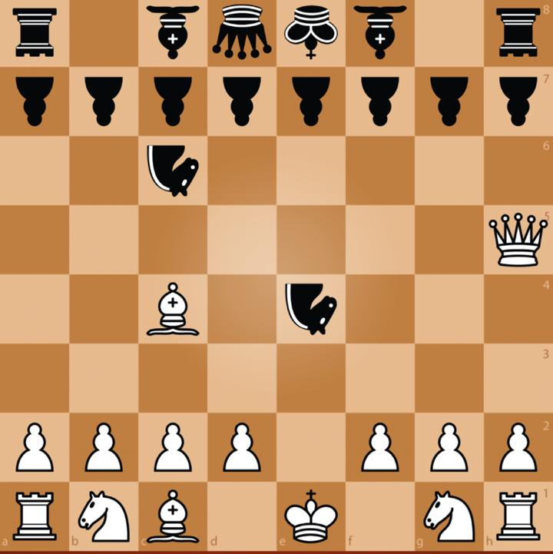

Slide 33


Slide 34


